Slide 1
Why we should ‘shock and kill’
Professor Sharon R Lewin, FRACP, PhD, FAHMS
Director, Doherty Institute, The University of Melbourne and Royal Melbourne Hospital
IAS Community Workshop of HIV Cure, Amsterdam, July 2018

Slide 2
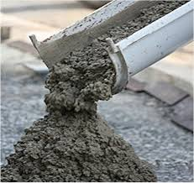
Some definitions
Shock and kill
Block and lock

Slide 3
The overall goal
Safe
Time limited
Cheap
Accessible
Effective in all clades
Eliminate viral rebound off ART
through
Reducing the replication competent reservoir

Slide 4
Shock and kill: a two step strategy
Kill
Immune mediated killing
or
Pro-apoptotic drugs
Shock
Latency reversing agent
Latent infection
Productive infection
Cell death

Slide 5
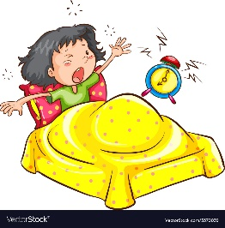
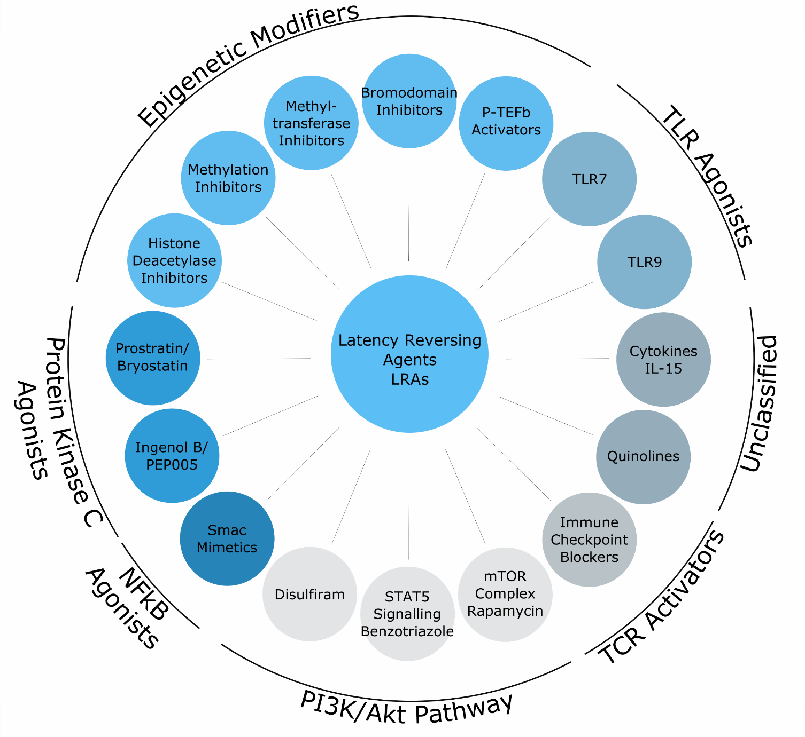
We have many drugs that can ‘shock’
None are HIV specific
None are as potent as T-cell activation
Unclear if virus is coming from all cells or just a few
Still need better LRAs
dCA
Kim, Anderson and Lewin. Cell Host Microbe 2018

Slide 6
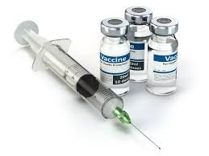
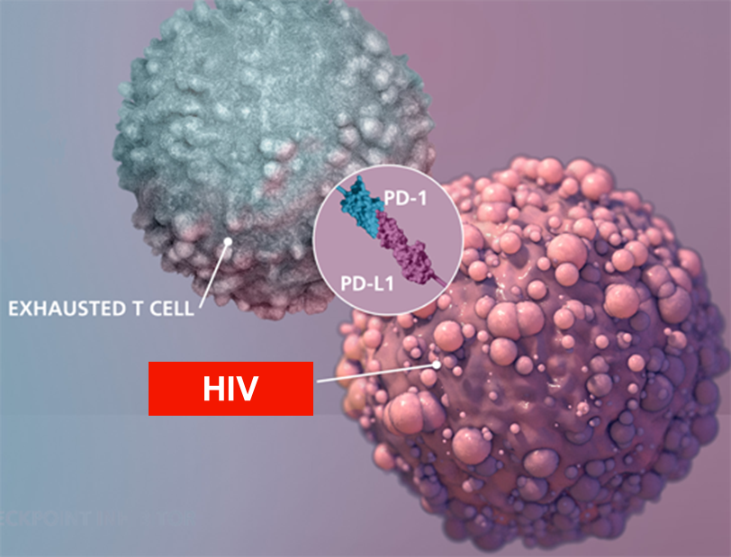
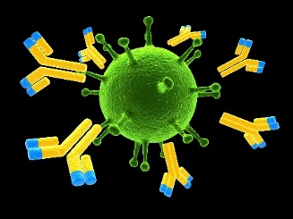
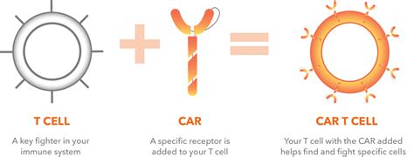
What about the kill?
Vaccines
Immune check point blockade
Antibodies
bNAbs
CAR T-cells
BITEs
DARTs

Slide 7
What happens when we combine shock + kill?
shock
kill
Romedepsin
Vacc 4x
REDUC
Lancet HIV
N=17
+
=
No change in DNA
Romedespin
ChAd/MVA
BCN02
CROI2018
N=15
+
=
Viral rebound (half)
Vorinostat
ChAd/MVA
HIVcons
RIVER
AIDS 2018
N=60
+
=
No change in DNA
TLR7
PGT121
bNAB
monkeys
+
=
REMISSION
(50%)

Slide 8
Kill compounds
Shock
+
HIV proteins/RNA
Latent infection
Cell death
Cummins J Virol 2016
Wong Nat Med 2016
Cummins AIDS 2018
Kim AIDS2018
Munoz-Arias AIDS2018
OX40/SIRC
survival
Cell death
Kuo, Immunity 2018

Slide 9
What are the challenges for shock and kill?
Need more potent, less toxic and more specific agents that shock. Combinations of shock agents coming
Unclear if targeting all infected cells will be possible, especially tissue
Could activating virus have adverse effects on immune activation, brain reservoirs? No evidence in 10+ trials
Immune escape might be a problem for immune mediated killing but not kill compounds
This is just about reducing the reservoir - will still need long term immune control

Slide 10
What will be better?
Shock and kill
Block and lock
Safe
Time limited
Cheap
Accessible
Effective in all clades
Induce remission off ART

